Slide 1
Lung cancer mortality
Machine Learning Project
Rabia Afzal & Amaia Urquia Samele

Slide 2
Outline:
EDA
Three Machine learning models
Comparison of models and conclusion
Understanding data limitations and the topic area

Slide 3
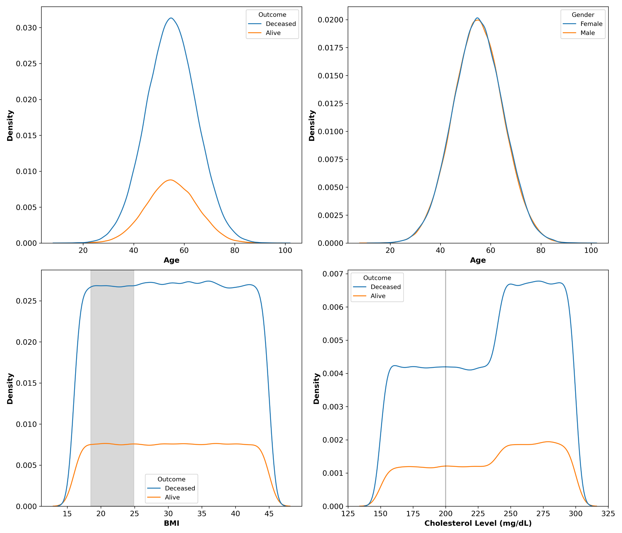
Data distribution
Non normal data
Similar distributions between outcomes and parameters suggests homogenous data

Slide 4
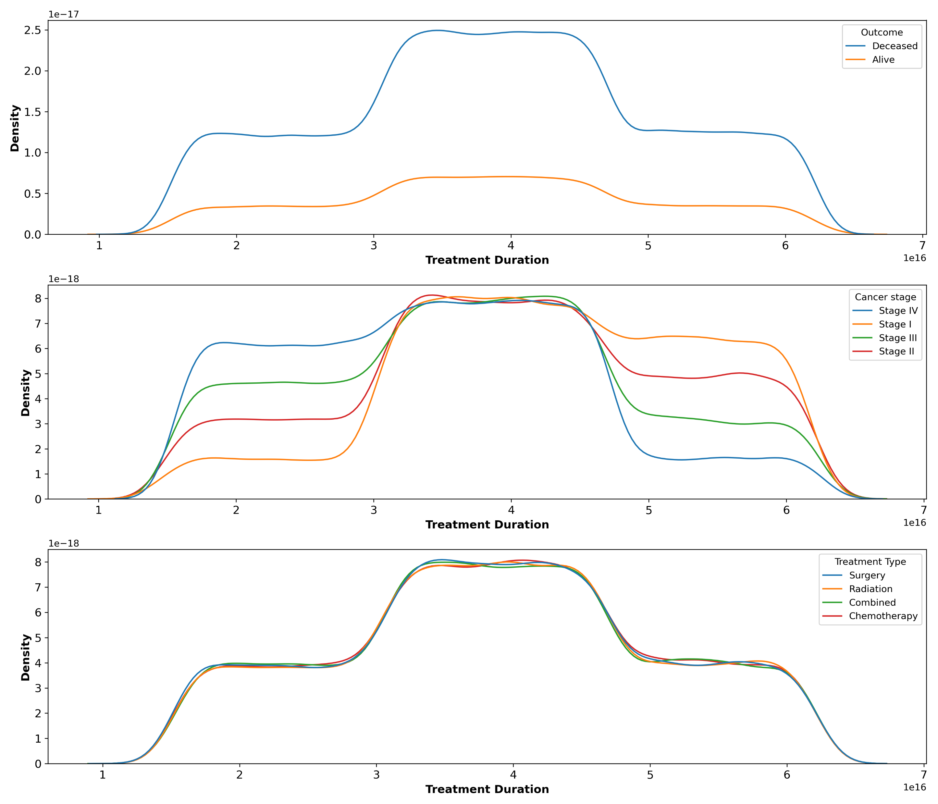
Data distribution
No differences in treatment length between cancer stage or treatment duration

Slide 5
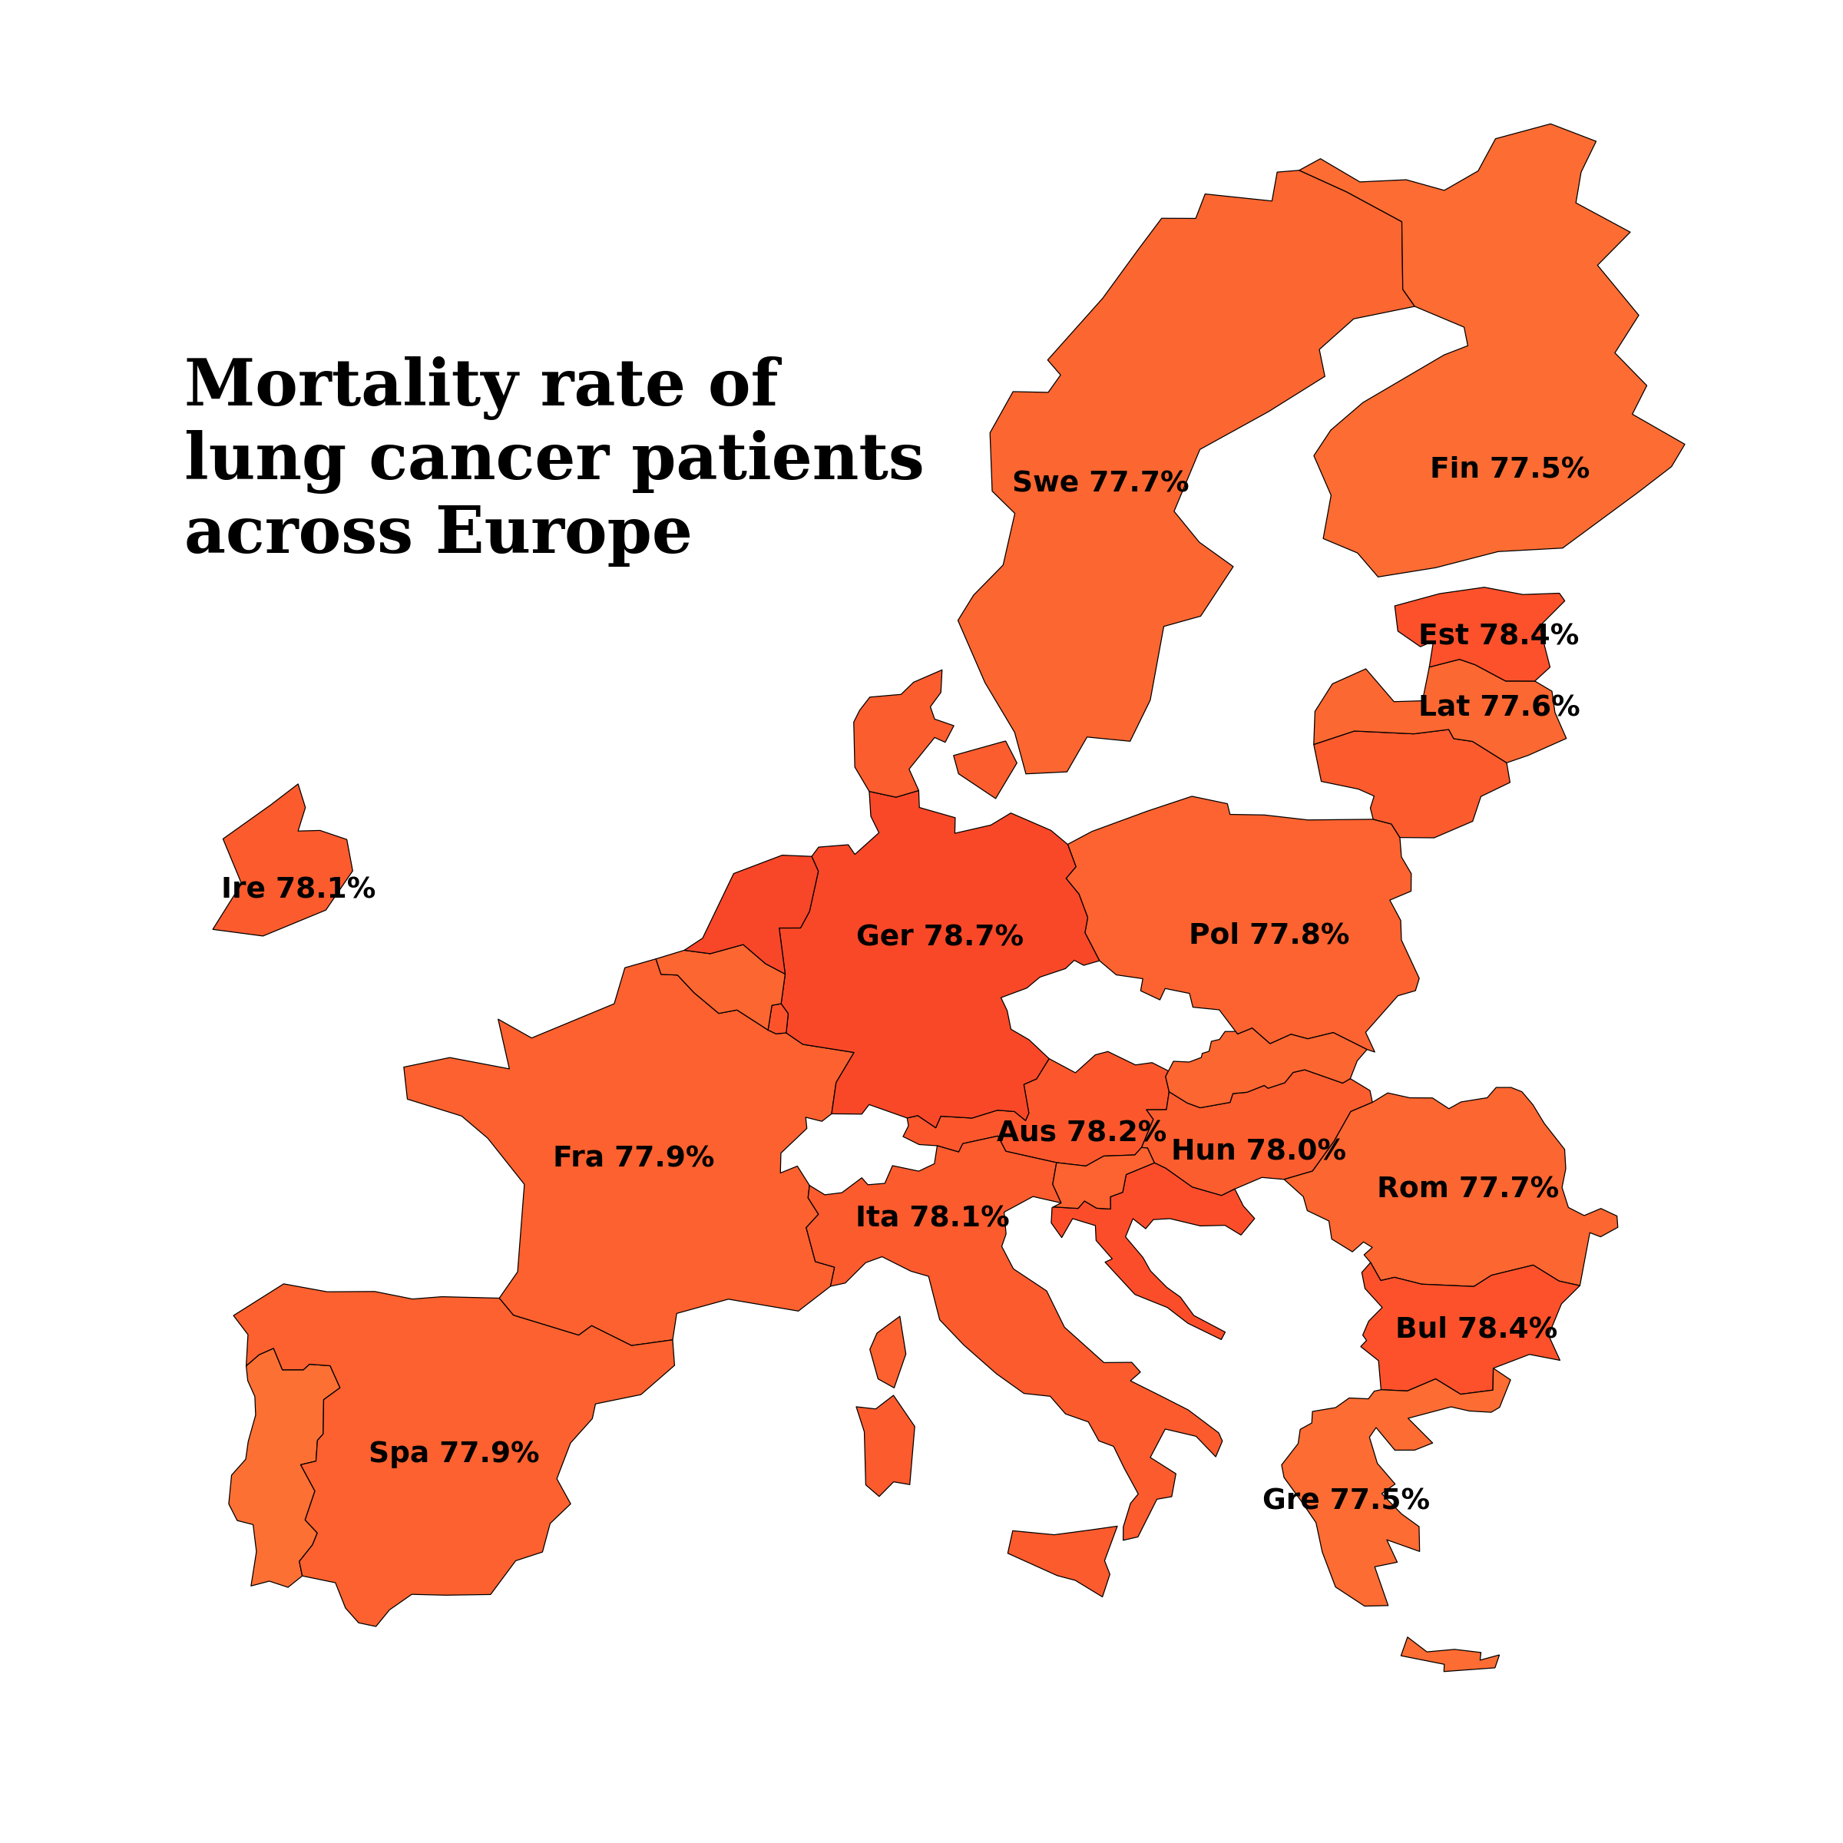
Mortality vs country
Small variation in mortality though no significant different between country
1.2% difference between max and min

Slide 6
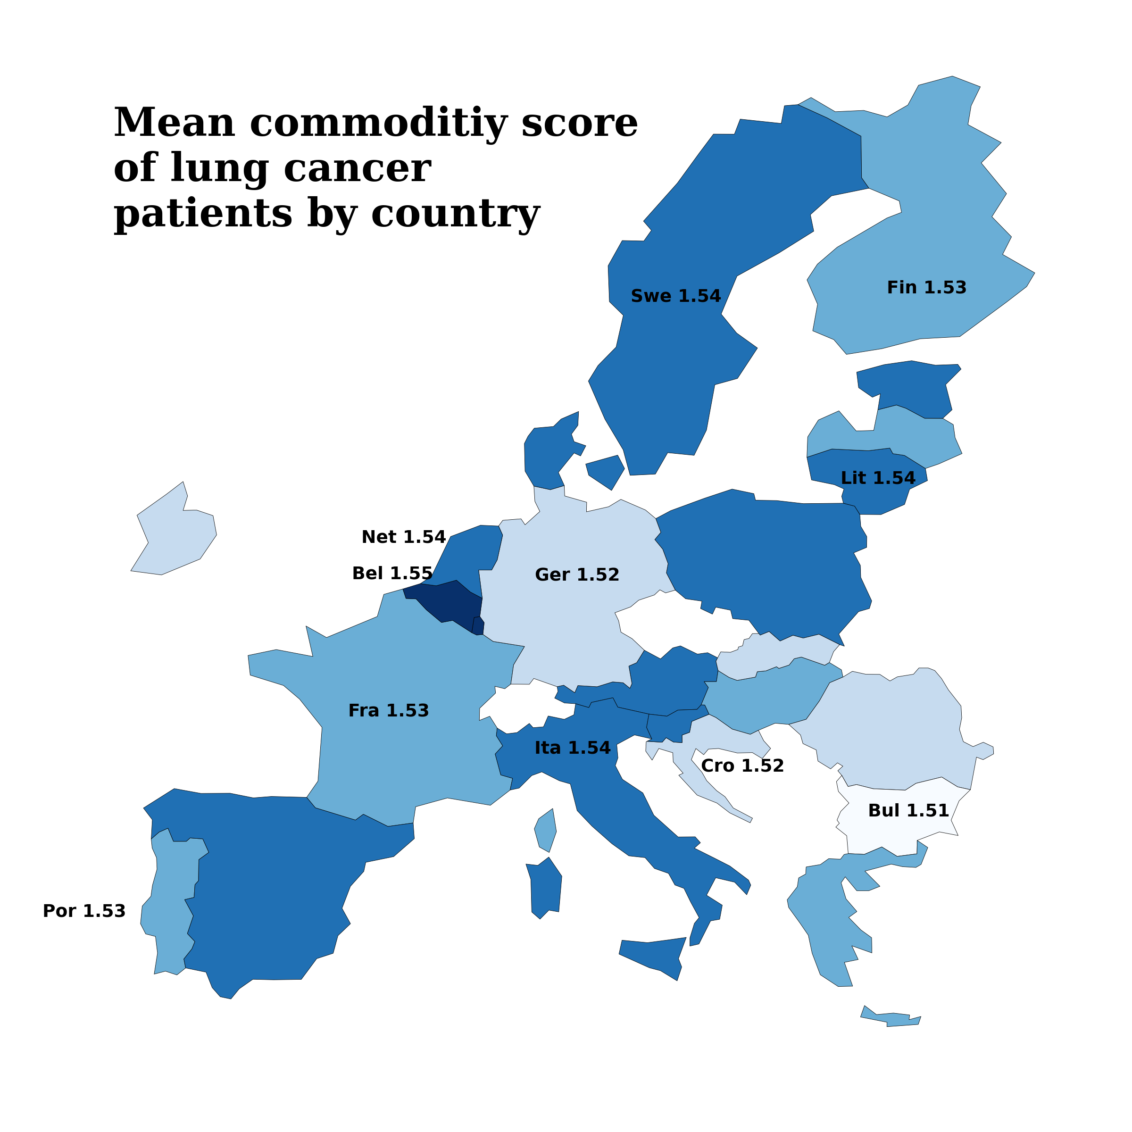
Health parameters vs countries
Creating a scaled health metric combining commodities to map distribution across Europe.
This score included: hypertension, asthma, cirrhosis,
0.04 difference between max and min

Slide 7
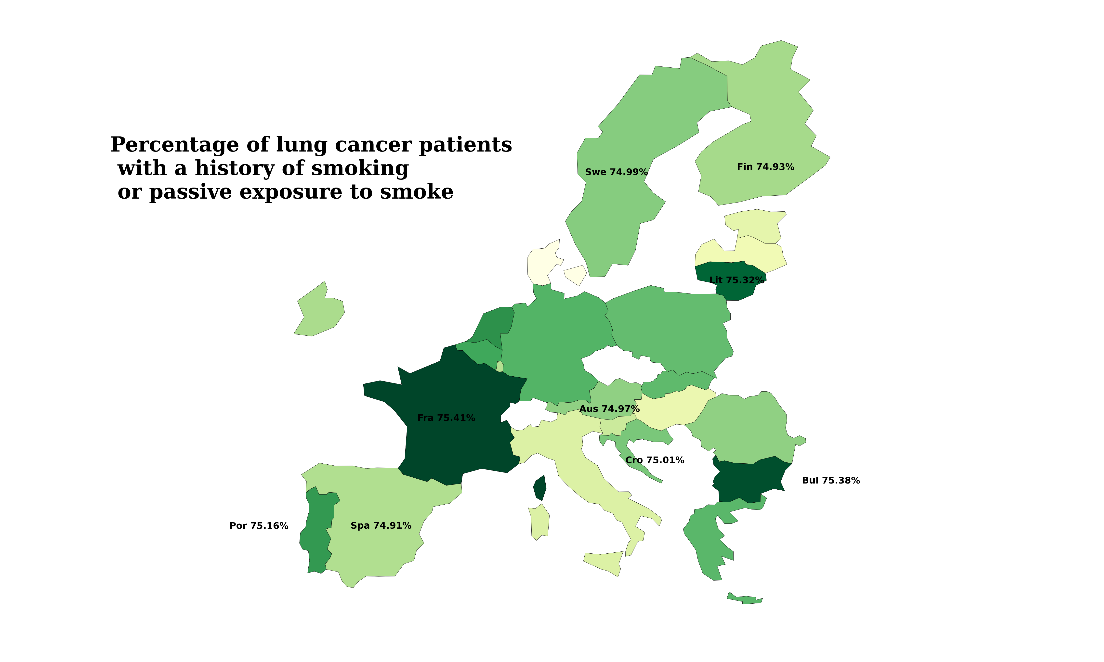
Smoking across Europe
Similar trend, not much variation

Slide 8
We can’t see many patterns, especially considering the range of results is so small
Suggests that health and smoking habits do not greatly differ by region

Slide 9
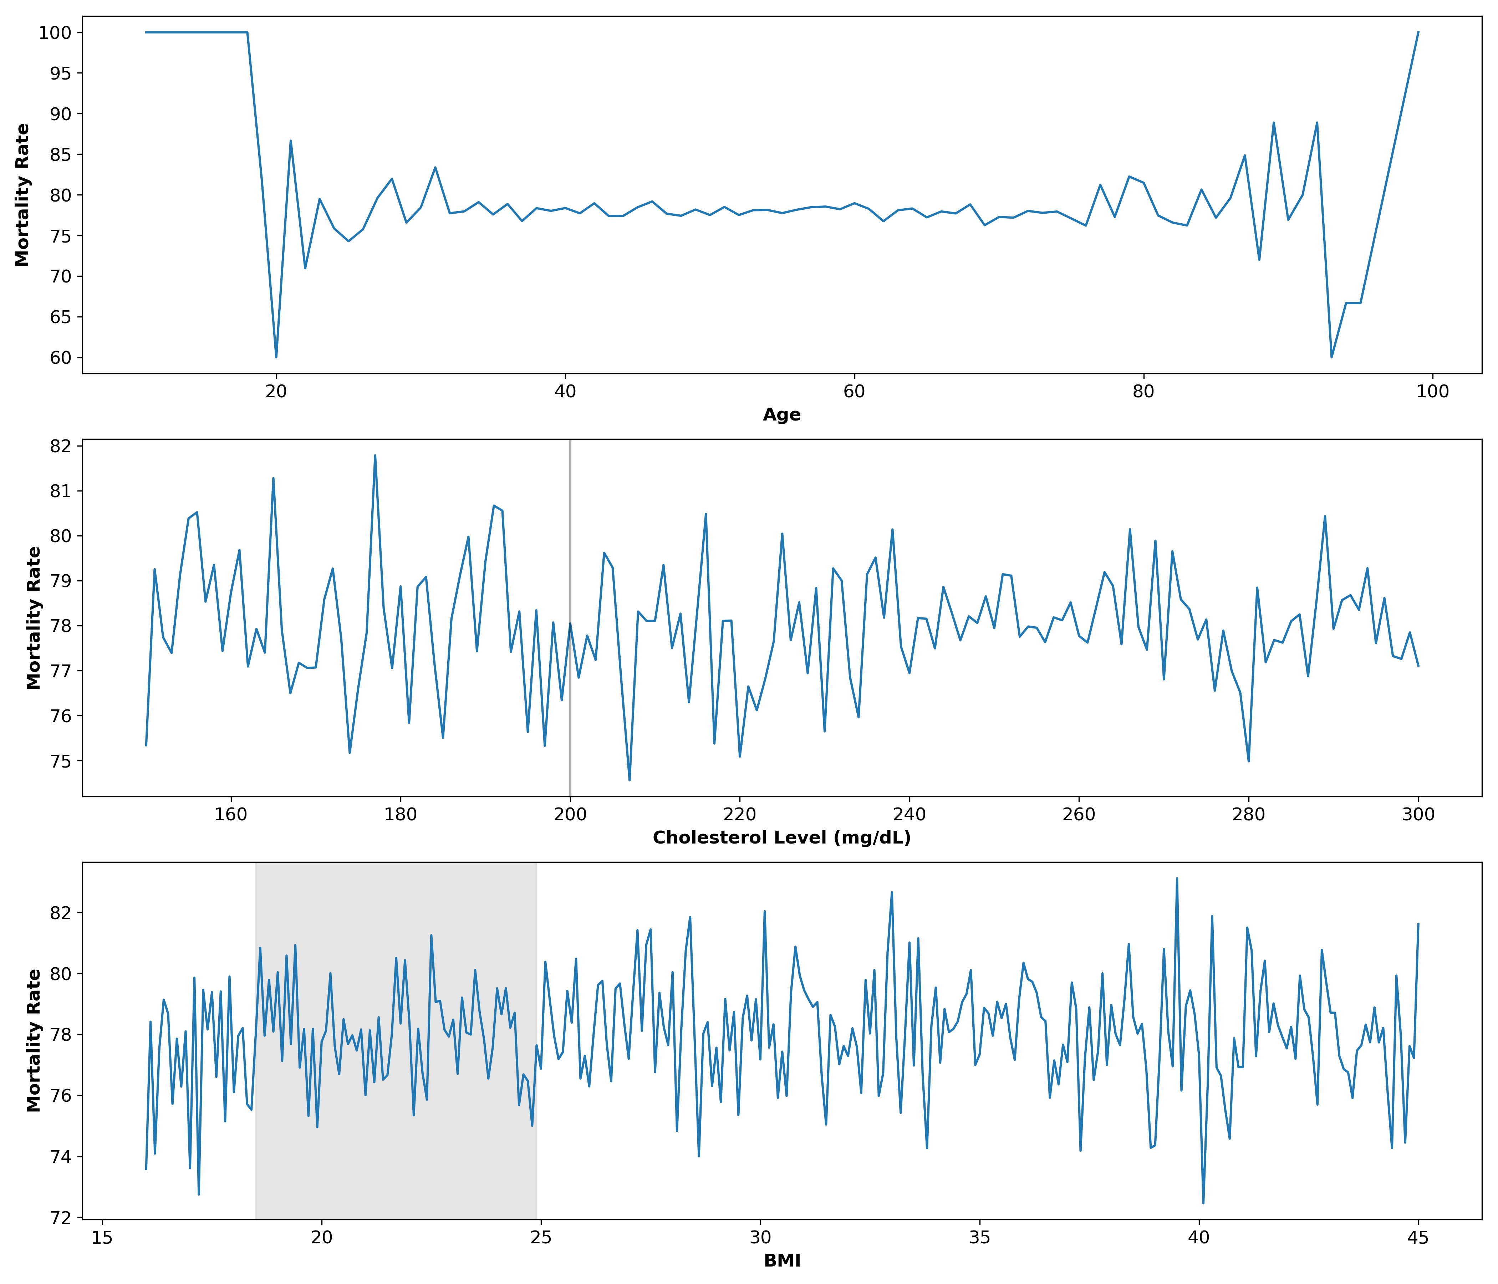
Continuous variables vs survival
Mortality rate fluctuates at young and older ages.
(Mann-Whitney U Test, U= 2269126354.5, p = 0.452
T test suggests while not significant the mean age of survival is higher than for patient that did not survive
Notes:
Talk about how

Slide 10
Continuous variables vs survival
Reported literature suggests that there is an increase in deaths where patient cholesterol is below 170
We can see high peaks of mortality and fluctuation below 200 mg/dl (threshold for high cholesterol)
While not significant our statistics suggests the mean is higher for patients who did not survive (Mann-Whitney U Test, U= 2259089271.5, p =0.596)

Slide 11
Continuous variables vs survival
Uniform fluctuations in BMI.
Mann-Whitney U Test suggests a higher BMI for patients that did not survive (Mann-Whitney U Test, U= 2269126354.5 , p = 0.452)
We can see this visualised with peaks in mortality at a BMI between 33 and 40

Slide 12
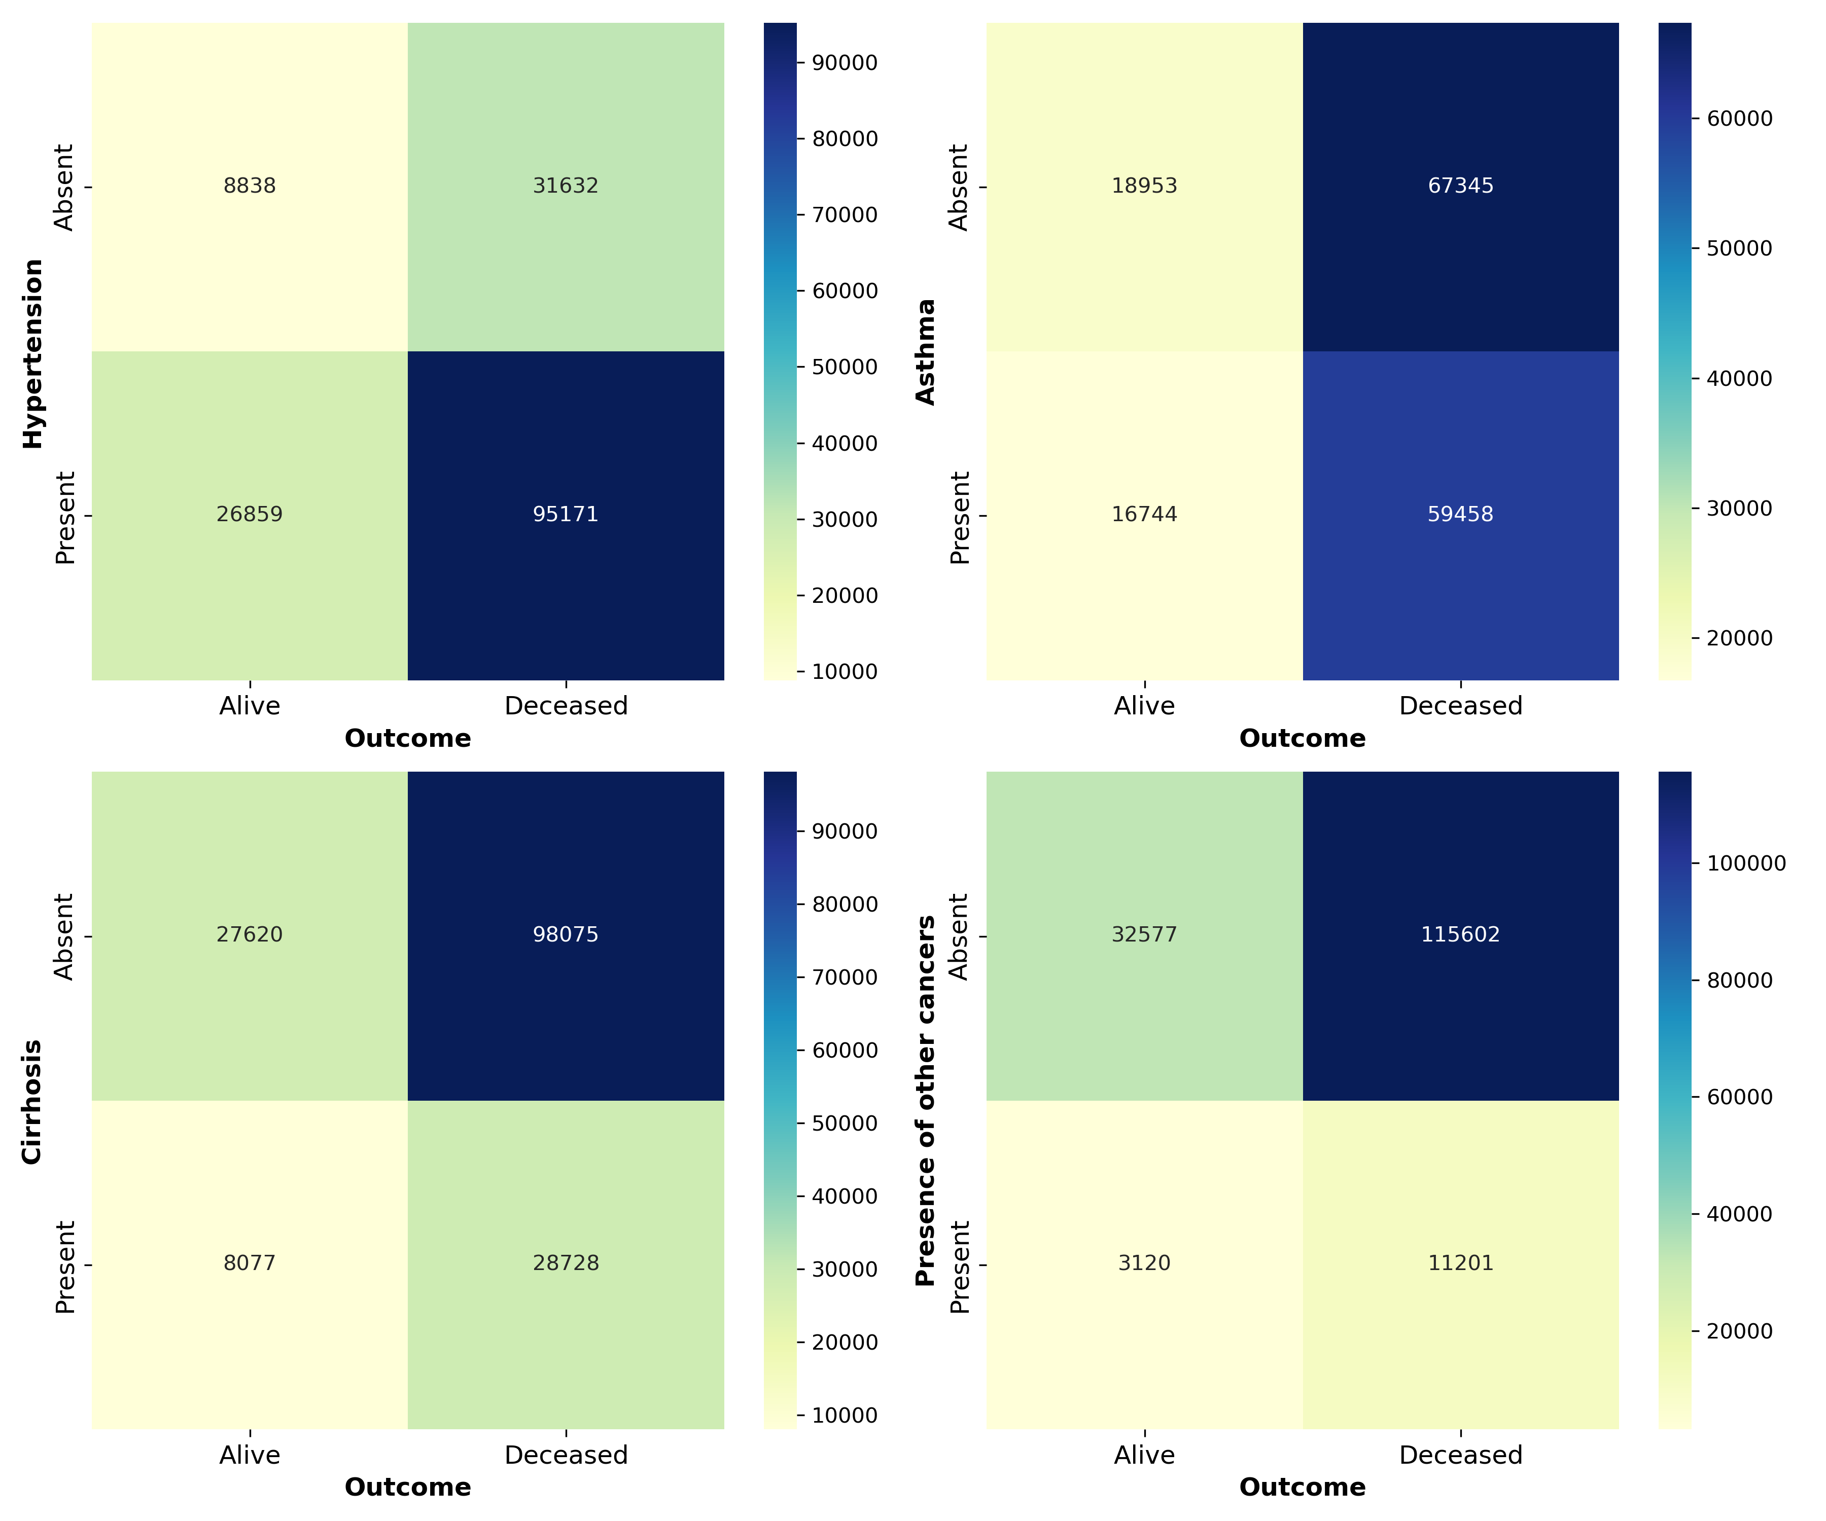
Health parameters
Much higher proportion of deaths compared to all groups (expected given the class imbalance)

Slide 13
Machine learning Models
Machine learning (ML) is a subfield of artificial intelligence that involves training algorithms to learn patterns and make decisions from data.
The goal of machine learning models is to make accurate predictions or decisions on new, unseen data.
In this project we used and compared three techniques for our classification problem:
Logistic Regression (LR)
Random Forest (RF)
Neural Network (NN)

Slide 14
Steps for Data preparation for Models
Assigning outcome variable y and independent variables X
We focused on parameters that had been included in the health score and opted to remove patient country as well as treatment durations.
One hot encoding for categorical features.
Perform a train/test split with test_size = 0.2 and a random state of 42.
Normalize the data by StandardScaler for Logistic Regression and Random Forest. Use the MinMaxScaler to normalize the features for Neural Network.
Apply SMOTE to deal with class imbalance. SMOTE (Synthetic Minority Over-sampling Technique) is used to balance the class distribution of a dataset by creating synthetic examples of the minority class.

Slide 15
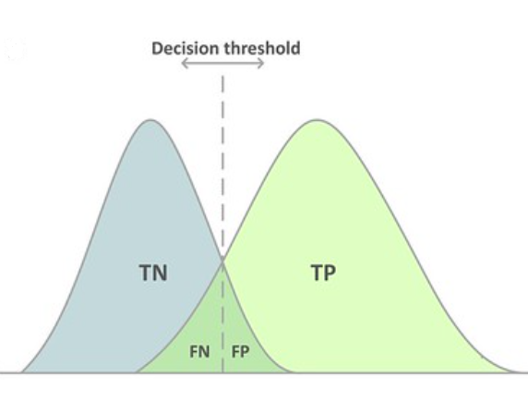
Logistic regression (LG)
We trained the LG model by finding the optimal threshold which is crucial for improving the performance and effectiveness of a classification model.
In the context of classification models, a threshold determines the point at which the predicted probabilities are converted into specific class predictions.
In binary classification, models typically output a probability (or score) between 0 and 1 for the positive class
The default threshold for classifying a sample is 0.5 and might not be optimal for our metric.
The threshold is a value between 0 and 1 that you use to decide whether to classify an instance as positive or negative.
The choice of threshold can significantly impact performance metrics like accuracy, precision, recall, and F1 score.
Supervised ML classification technique used to predict the probability of an observation belonging to a certain target class, given a set of predictor variables.

Slide 16
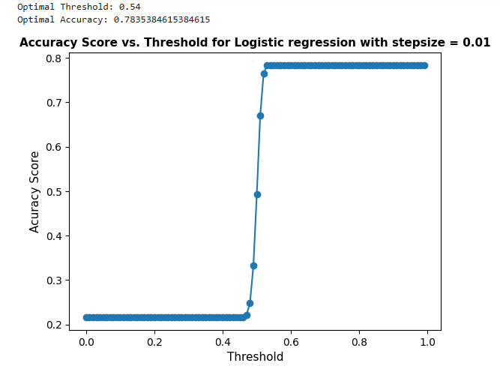
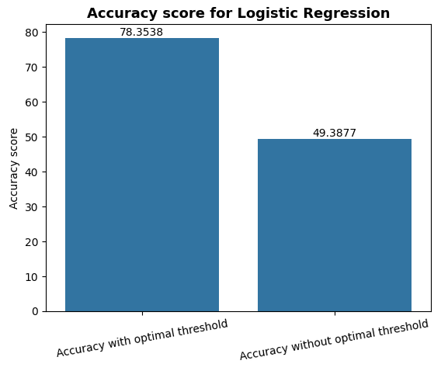
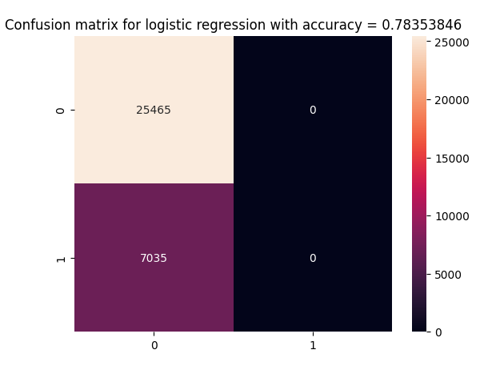
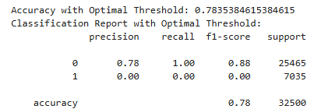
Logistic regression
It can be noticed how a choice of threshold can affect the metric, for instance accuracy.
Better accuracy score might make the correct predictions for most of the instances, but recall is zero on 1 displayed in classification report, that means the model must predict the false negatives (FN) and isn’t able to predict the actual survived cases in the dataset, missing a considerable number of survived cases.
We can see the model predicted 7035 false negative (FN) cases. We next need to train our model for improving our F1 score.

Slide 17
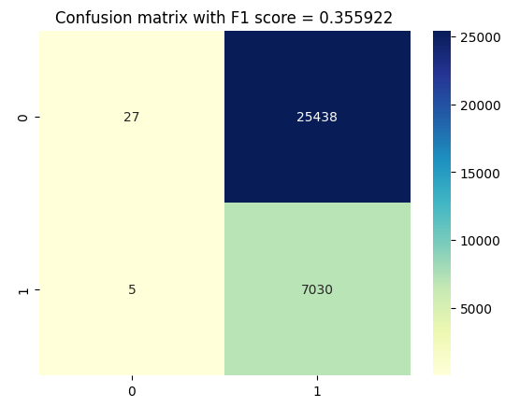
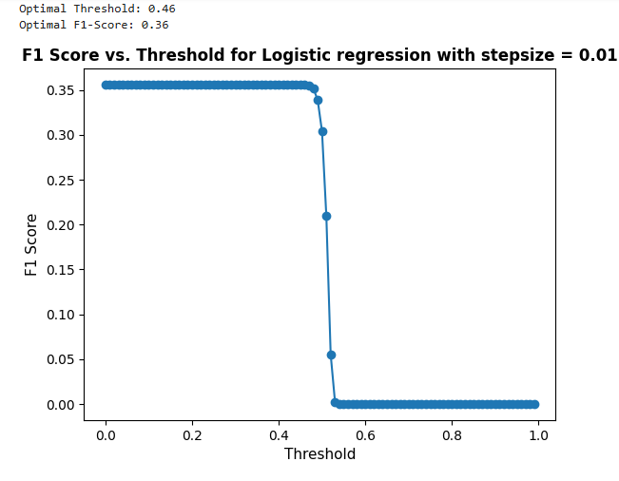
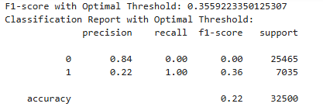
Logistic regression
Our precision score is still relatively low on 1, that means model predicts 25438 false positive (FP) cases, i.e identifying dead cases as survived cases.
Only 22% precision on 1 of all predicted survived cases are actually survived cases.
Finally, this LR model is not able to manage the balance between both scores, accuracy and F1 score.
Analysis: We can notice that F1 score has improved with 36%, however, the accuracy of the model has decreased. This phenomenon is known as the F1 score-accuracy trade-off, whereby improving one metric may cause a decrease in the other. The main reason behind this issue is the unbalanced nature of our data. Since we have limited match information and consider a 5% sample of very large dataset, our model is unable to learn effectively.

Slide 18
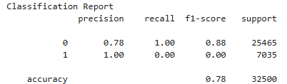
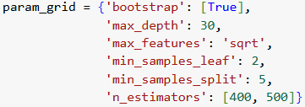
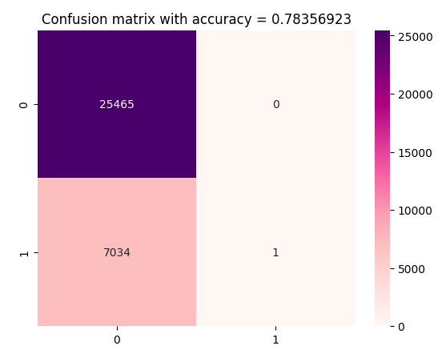
Random forest (RF)
It works by creating a "forest" of decision trees.
The algorithm then makes predictions for each tree, and the final result is determined by averaging the predictions of all the trees in the forest.
Tuning Hyperparameters:
Analysis:
By tuning the hyperparameters, we managed to increase our accuracy, but not precision and recall given in classification report.
78% accuracy of the model captures dead cases, but it doesn’t capture the survived cases.
We have similar situation to logistic regression for recall score.
Our next step was to improve the precision and recall.

Slide 19
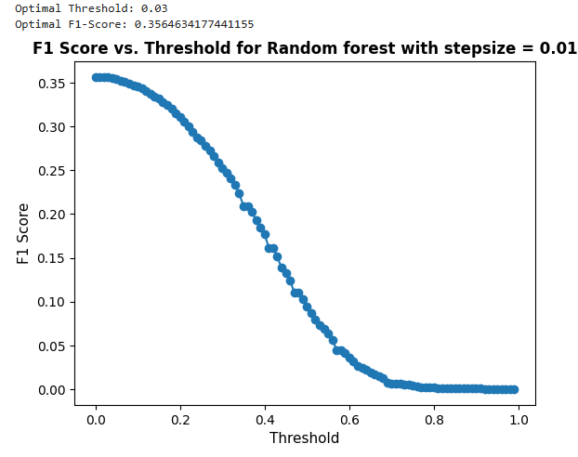
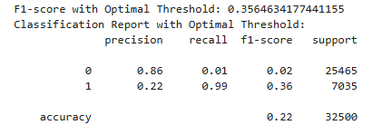
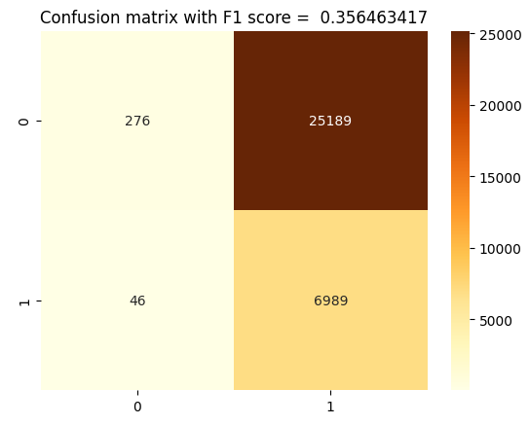
Random forest (RF)
recall is very good on 1, which indicates model is good at detecting all the survived cases in the dataset, only predicts 46 false negative (FN) cases.
To conclude, the RF model is not sufficient to maintain a balance between both scores.
Normally, this trade-off between F1 score and accuracy arises primarily in cases of imbalanced datasets, where the data is not distributed very well or the number of instances in different classes is not equal
By finding the optimal threshold, we managed to increase the precision score to match predictions with a low accuracy of 22% shown in classification report.

Slide 20
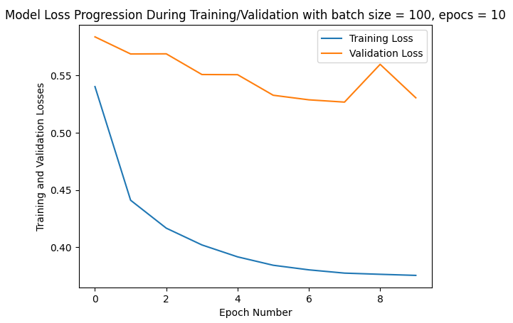

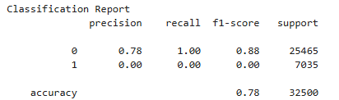
Neural Network (NN)
NN model with:
Input layer - 23
Hidden layer - 12 nodes, activation ReLu, input features
Hidden layer - 8 nodes activation ReLu
Output - 1 node, activation sigmoid
Tuning Hyperparameters:
Accuracy: 0.783538 using {'batch_size': 20, 'epochs': 30}
Accuracy: 0.783538 using {'batch_size': 100, 'epochs': 10}
Accuracy: 0.783538 using {'batch_size’: 200, 'epochs’: 15}
Analysis:
We started with a small model, consisting of a small number of layers, utilizing Dense layers where each layer is connected to every node. For our binary classification task, we set our final layer to contain only one neuron with a Sigmoid function.
Mean squared error for each iteration is quite high
However, our model is not learning well with 78% accuracy shown in classification report.
We tried to get the better accuracy for different batch size and epochs highlighted by yellow. Noticeably, we concluded a result that efficiency of the model is bounded by 78% accuracy with different batch size and epochs for this sample dataset.

Slide 21
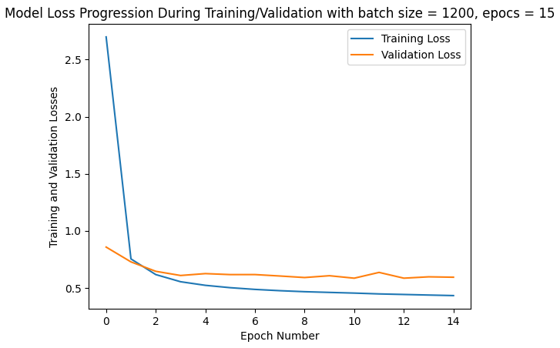
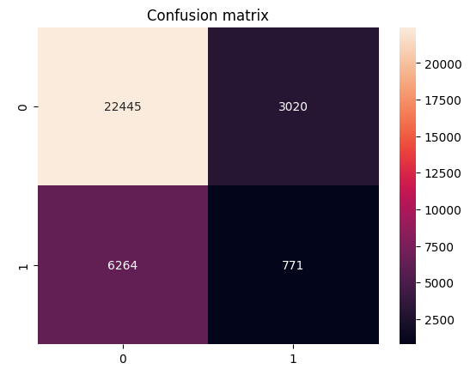
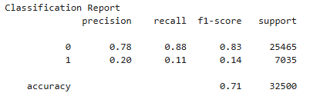
Neural Network (NN)
NN model with:
Input layer - 23
Hidden layer – 20 or 90 nodes activation ReLu, input features,
Dropout(0,6)
Hidden layer – 20 or 90 nodes activation ReLu,
Dropout(0,4)
Output - 1 node, activation sigmoid
Tuning Hyperparameters:
Epochs = 15
Batch_size = [1200, 2500]
Optimizer = [adam]
Analysis: The model is trained again with more nodes. Decreasing dropouts can be used to prevent overfitting. We can notice the model is learning better with improved precision and recall and accuracy is still good and does not drop rapidly. Even though we still have F1 score – accuracy trade off issue due to unbalanced nature of our data. As we have limited match information in our 5% sample dataset , our model is unable to learn effectively. Overall, the NN model may provide a good balance between F1 score and accuracy.

Slide 22
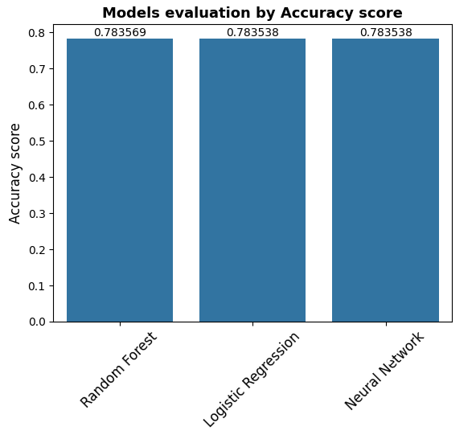
Comparison between Models and Conclusion
All models provide consistency for accuracy score with 78%.
As we improved the F1 score , the accuracy becomes very low in LR and RF models, but not in NN model. After comparing the errors produced by the models, we concluded that the most optimal choice might be to use Neural Network. Even though its recall and precision are lower on 1, but quite higher on 0 than other models. However, NN model gives a better balance between F1 score and high accuracy as compared to other models, shown in classification reports.
For further analysis, Neural Network can handle F1 score – accuracy trade off issue with collecting more data or for large dataset.
However, it is important to note none of the models achieve optimal results, so we would recommend conducting further feature engineering, and considering large data set so our models can learn better.
Logistic Regression
Random Forest
Neural Network

Slide 23
limitations
We know that machine learning models can be sensitive to sample size
What might look like a pattern on a big scale might be spurious correlations and what might look like a significant amount on a smaller scale might be caused by a sampling bias
It's important to note that this is particularly important for medical data
This likely contributed to prevalent in this case study

Slide 24
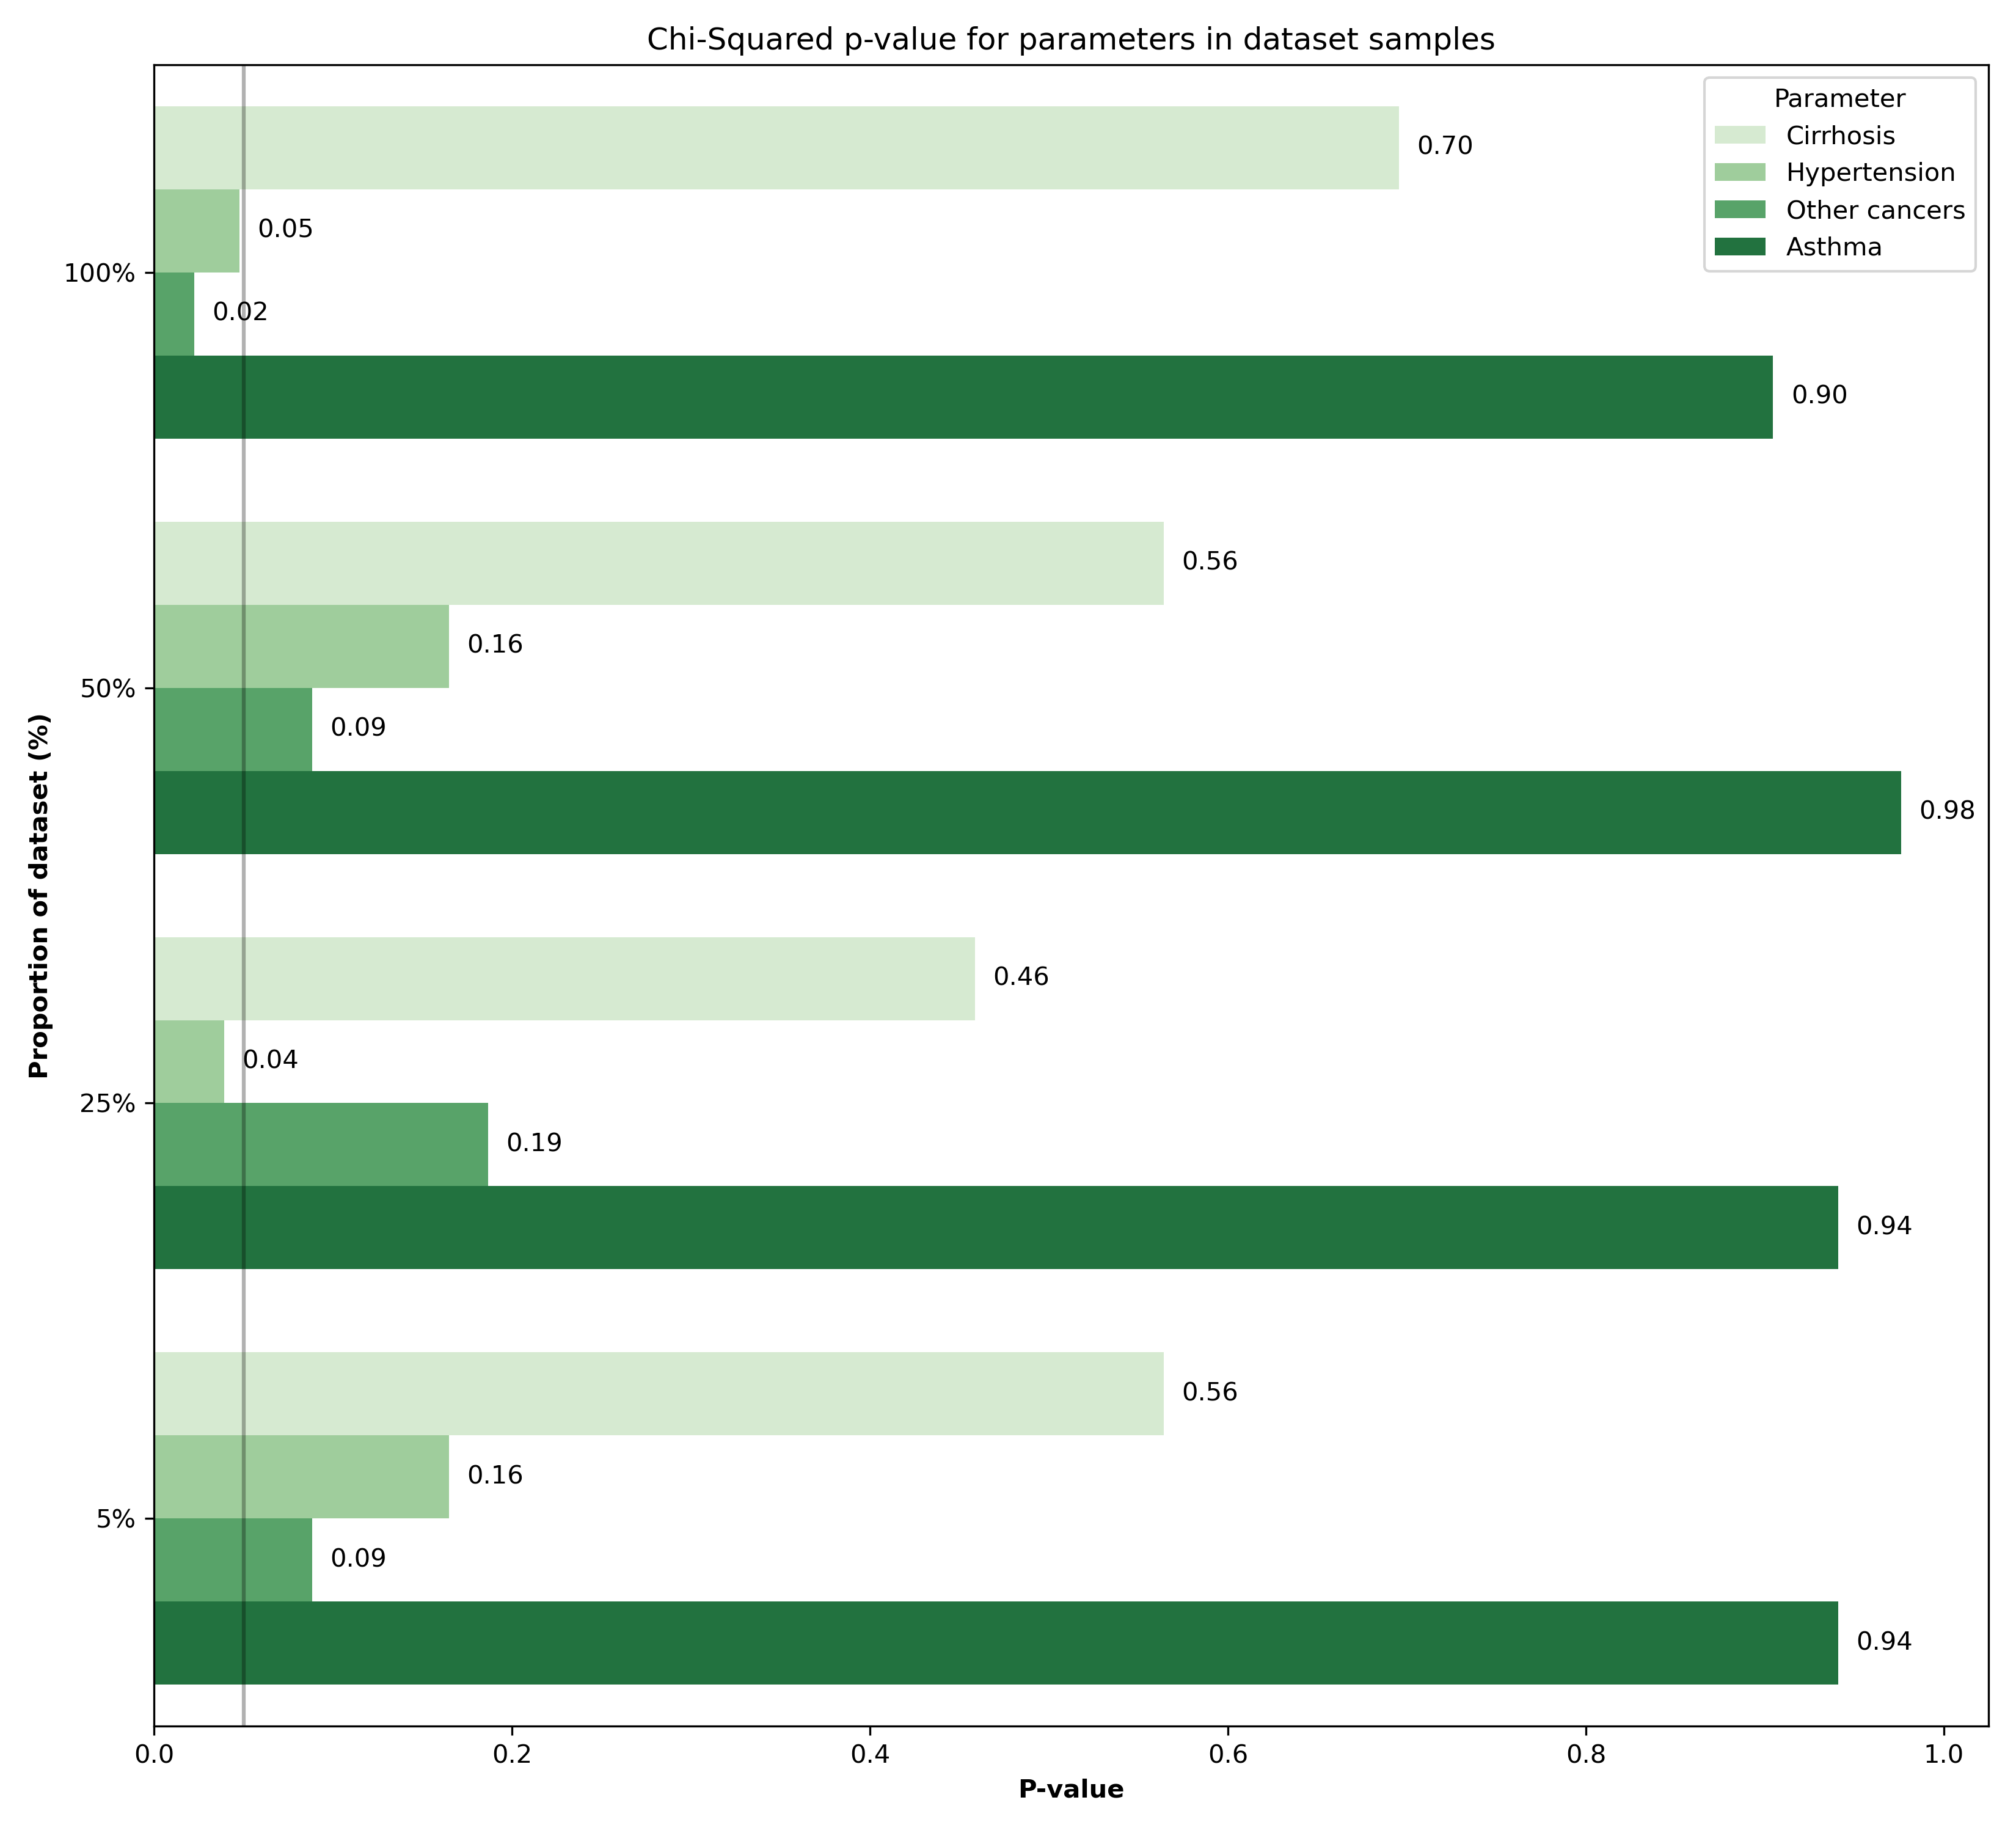
Sample size and statistical power trade off
0.05
Hypertension and presence of other cancers which have a statistically significant relationship with survival
Potentially these patterns were not picked up by the model because of the sample size we selected (because of computational limitations)

Slide 25
Sample size and statistical power trade off
OR = 1: No association
OR > 1: Positive association.
OR < 1: Negative association.
Parameters | Odds Ratio (OR) | P-value
Hypertension | 1.0061 | 0.0224
Other Cancers | 0.9886 | 0.0477
Even when a p value is significance it does not indicate the size of association
Running odds ratio suggests that even our parameters which are significant only have a small influence on survival
Having other cancers present slightly decreases risk of mortality
Having hypertension is a slight risk for lung cancer mortality

Slide 26
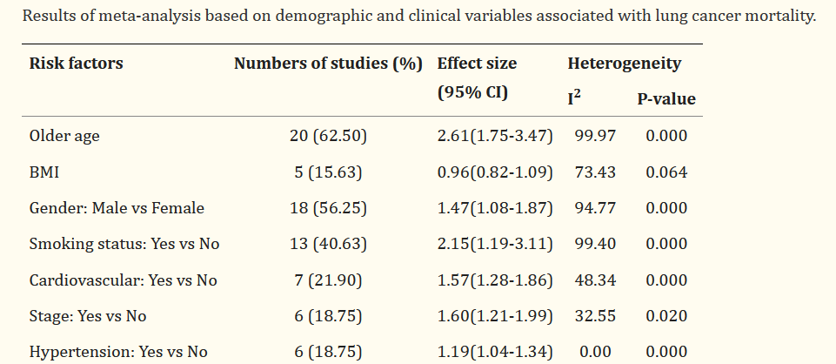
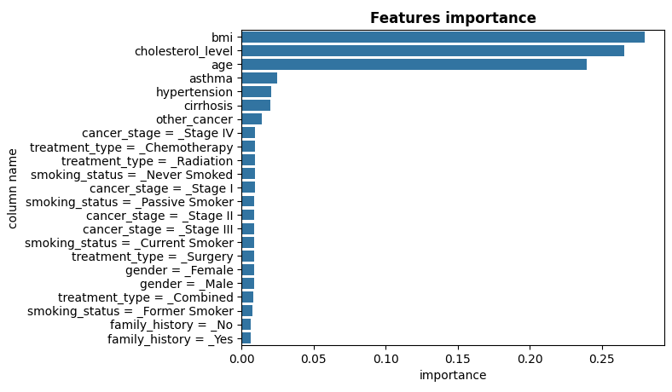
Published literature patterns and findings
Not a lot of agreement between studies
Our models did seem to pick up on features that are commonly reported on such as BMI and age
Publications on this topic show very high heterogeneity (contrasting conclusions)
This suggests they might not be reliable predictors and more research is needed

Slide 27
Conclusion
Predictors of mortality in lung cancer is a topical and highly debated topic
Much like any disease there are many factors that can influence outcome
As previously stated a larger dataset would help with feature selection and identifying strong predictors
There may be other unrecorded confounding effects which were not controlled for that influenced data distribution

Slide 28
References
https://www.ncbi.nlm.nih.gov/pmc/articles/PMC4296634/
https://www.ncbi.nlm.nih.gov/pmc/articles/PMC10754488/
https://www.sciencedirect.com/science/article/pii/S0085253815529748

